Slide 1
Artificial Intelligence
Yukyung Choi
2019.04.09
https://github.com/unizard/2019.Spring.AI

Slide 2
Agenda
Learning rate
Data preprocessing
Avoid overfitting
More training data
Regularization
Performance evaluation

Slide 3
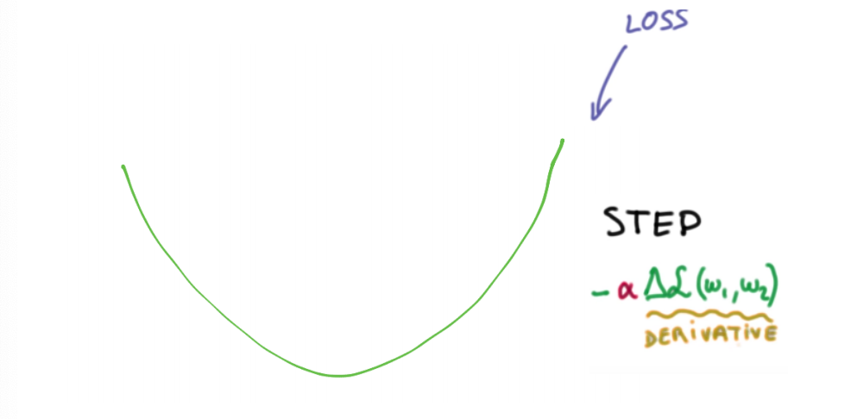
What is a Learning rate
Loss function

Slide 4
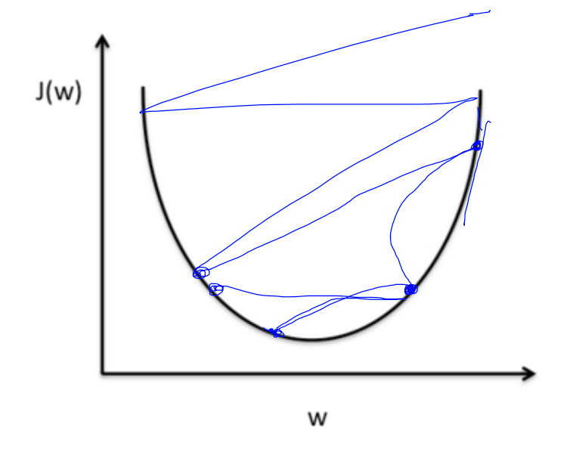
Large learning rate: overshooting

Slide 5
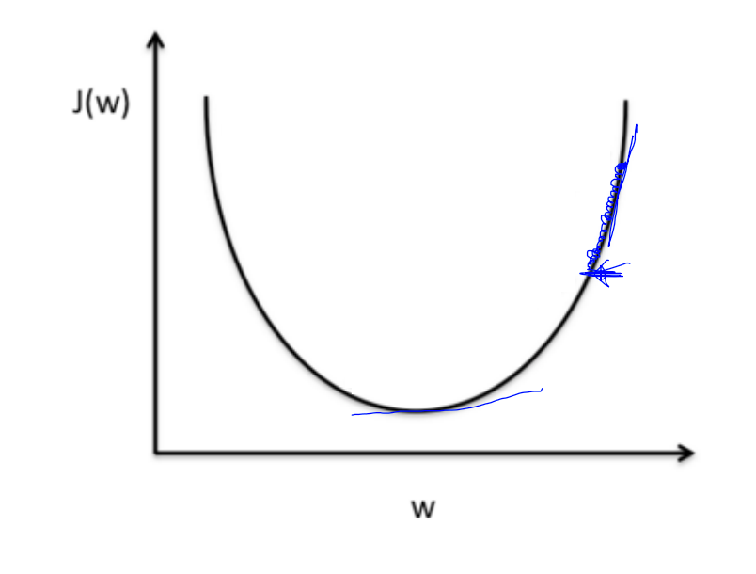
Small learning rate
Takes too long, stops at local minimum

Slide 6
Try several learning rates
Observe the cost function
Check it goes down in a reasonable rate

Slide 7
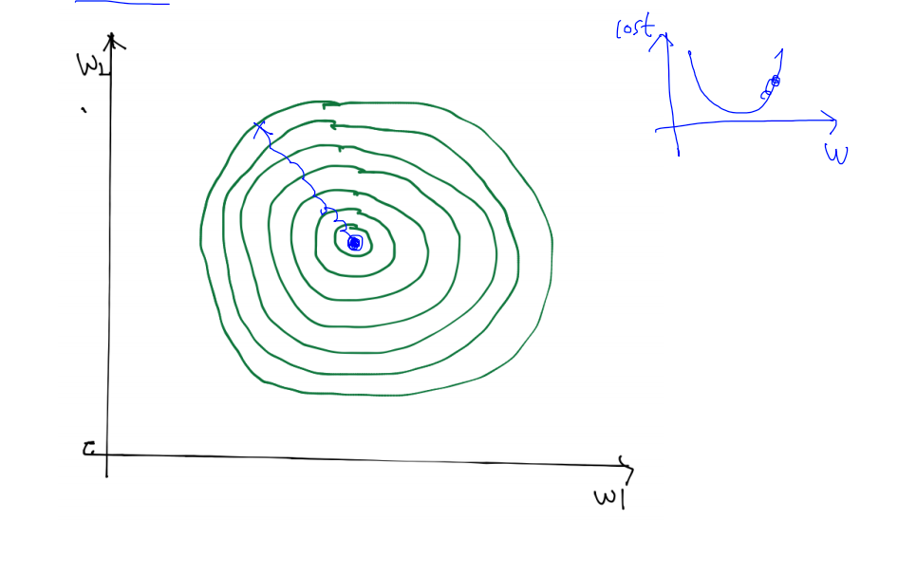
Data Preprocessing for gradient descent

Slide 8
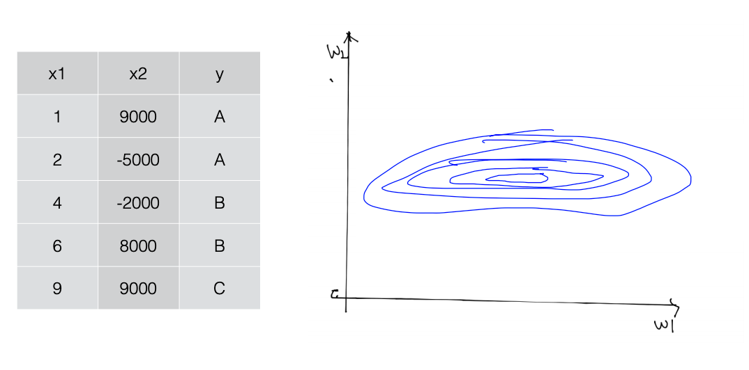
Data Preprocessing for gradient descent

Slide 9
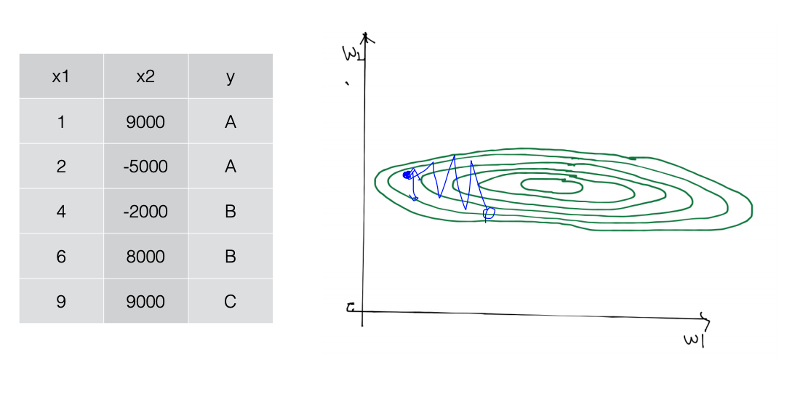
Data Preprocessing for gradient descent

Slide 10
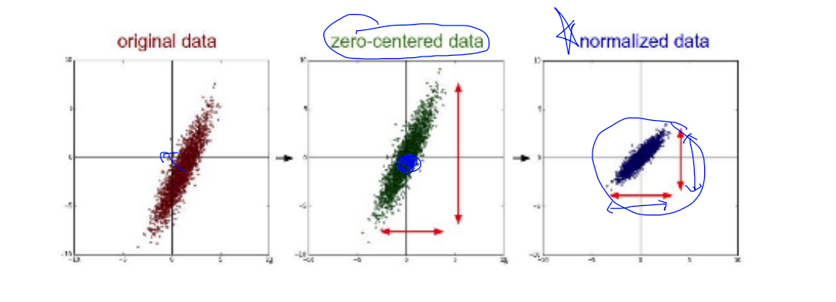
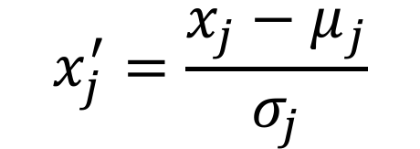
Data Preprocessing for gradient descent
$$x_{j}^{′}=\frac{x_{j}−μ_{j}}{σ_{j}}$$
Standardization:

Slide 11
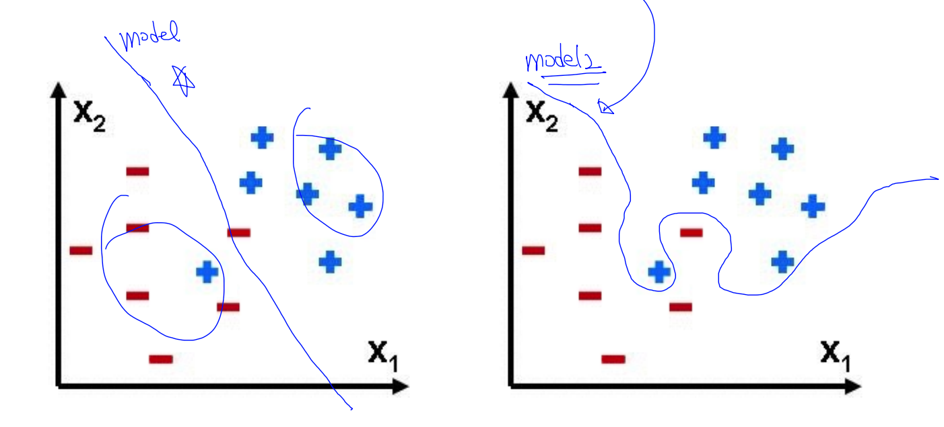
What is a overfitting
Our model is very good with training data set(with memorization)
Not good at test dataset or in real use
Good model
Overfitting model

Slide 12
Solutions for overfitting
More training data
Reduce the number of features
Regularization

Slide 13
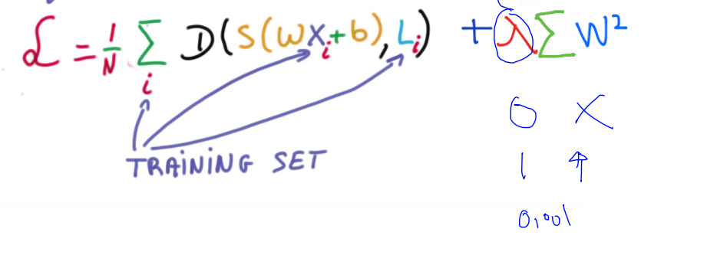
Regularization
Let’s not have too big numbers in the weight
Loss function
regularization

Slide 14
Performance evaluation
Use the learned parameter (W,b)
Use the unseen data
Do not use training data
ML
model
Data input
Predicted output

Slide 15
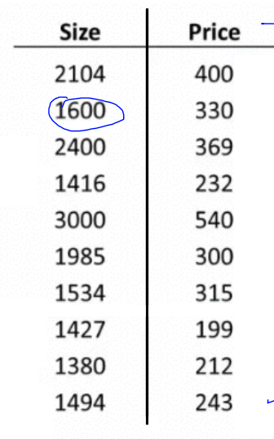
Evaluation using training set
Just memorization instead of understanding
For example) Examination
Training data
100% correct (accuracy)

Slide 16
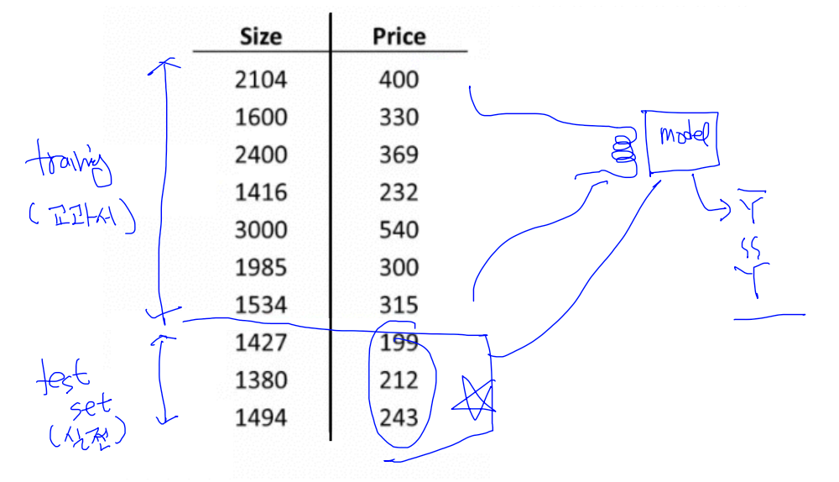
Evaluation using disjointed train & test sets

Slide 17
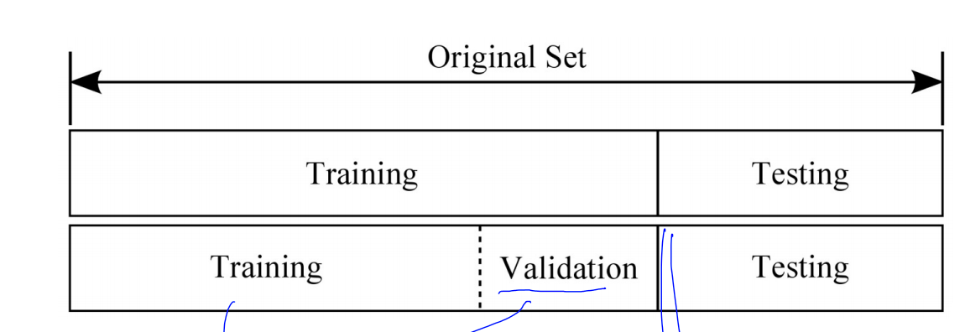
Training, validation and test sets

Slide 18
Summary
Learning rate
Data preprocessing
Avoid overfitting
More training data
Regularization
Performance evaluation

Slide 19
Agenda
History of MLP

Slide 20
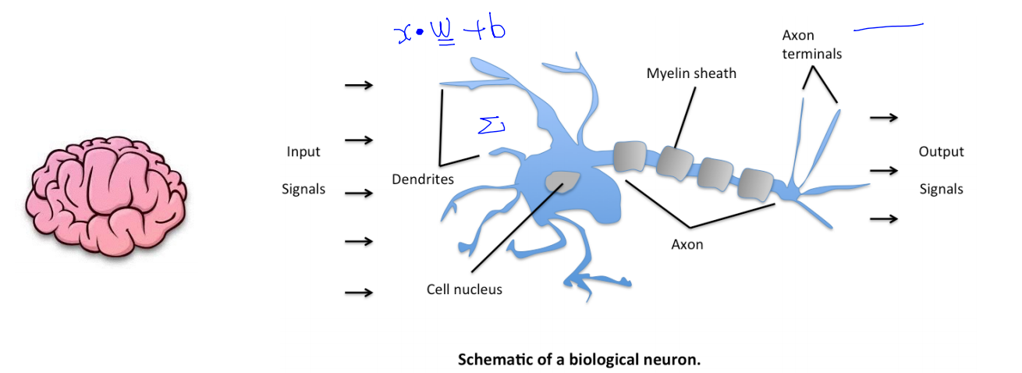
Ultimate dream: thinking machine

Slide 21
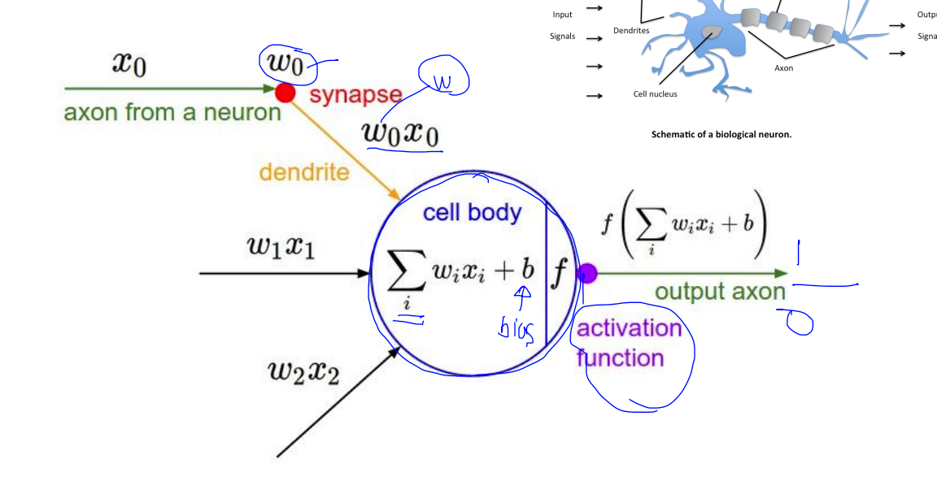
Activation function

Slide 22
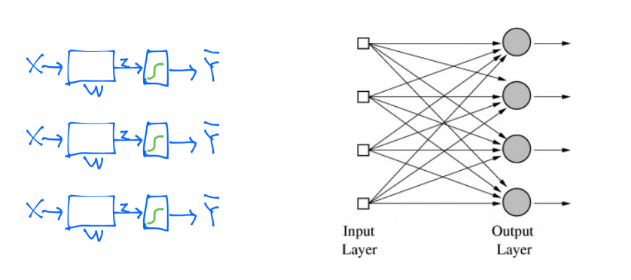
Logistic regression units

Slide 23
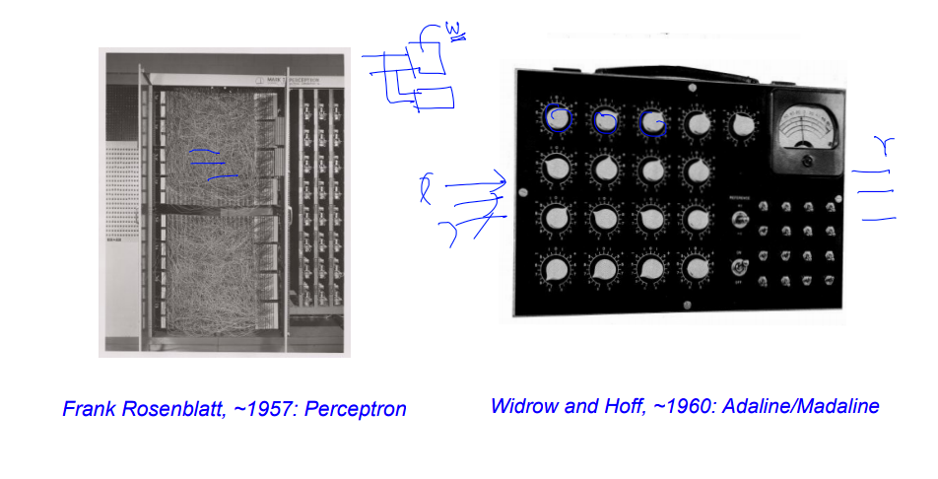
Hardware implementations

Slide 24
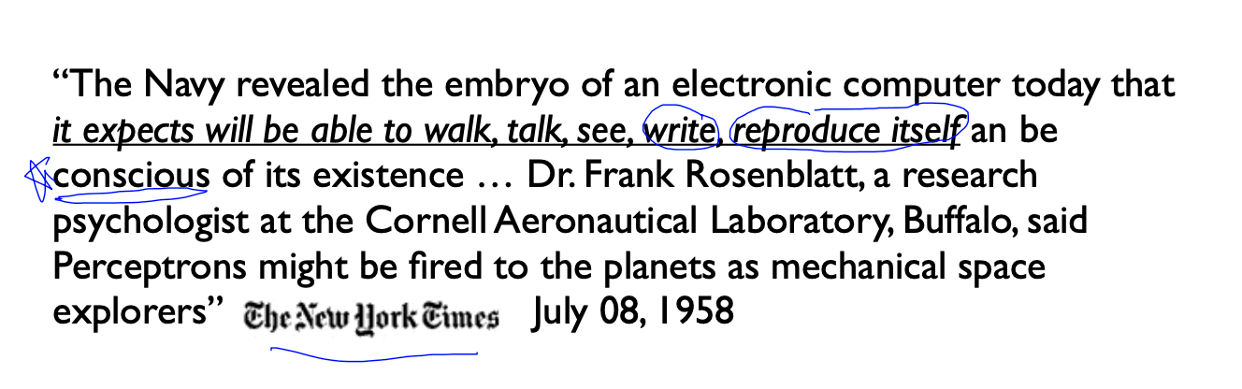
False Promises

Slide 25
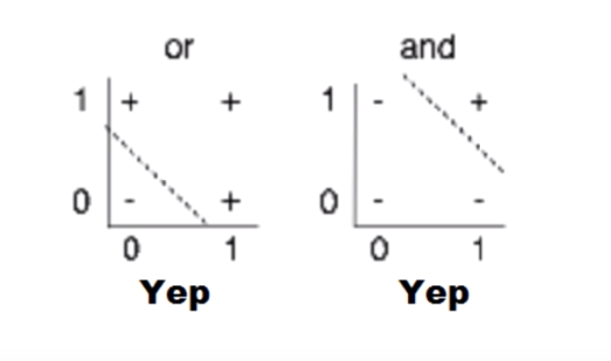
(Simple) AND/OR Problem: linearly separable

Slide 26
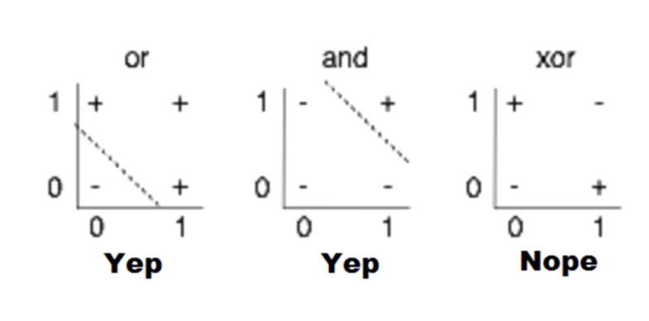
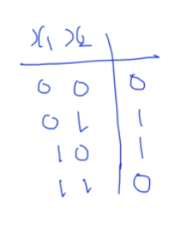
(Simple) XOR Problem: linearly separable?

Slide 27
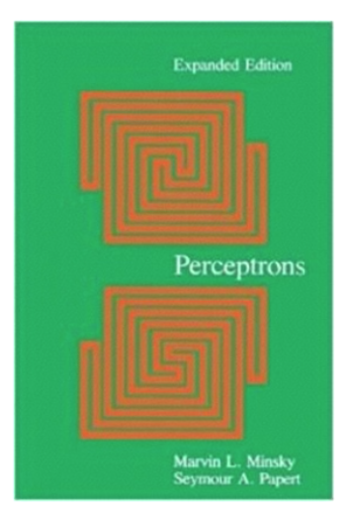
XOR Problem is
Perceptron(1969) by Marvin Minsky, founder of the MIT AI Lab
We need to use MLP, multiplayer perceptron (multilayer neural nets)
No on on earth had found a viable way to train MLPs good enough to learn such simple functions.

Slide 28
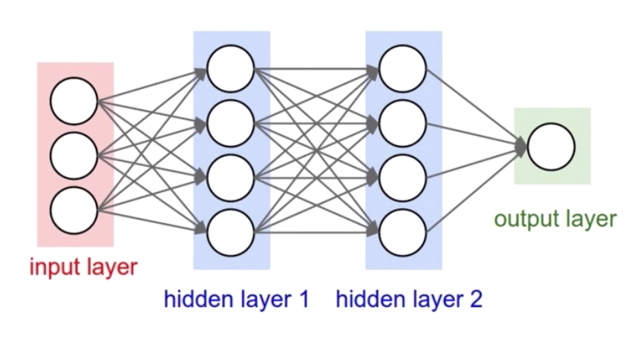
No one on earth had found a viable way to train*
Marvin Minsky, 1969

Slide 29
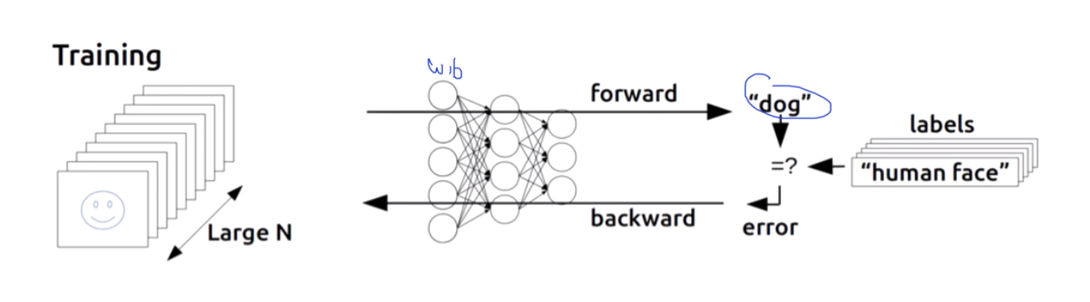
History of MLP training
Backpropagation (1974, 1982 by Paul Werbos, 1986 by Hinton)
Re-discovery: Backpropagation by Hinton
이후로, XOR보다 더 복잡한 문제를 풀기 시작함

Slide 30
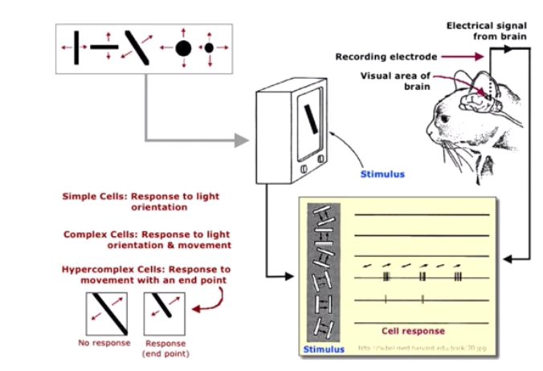
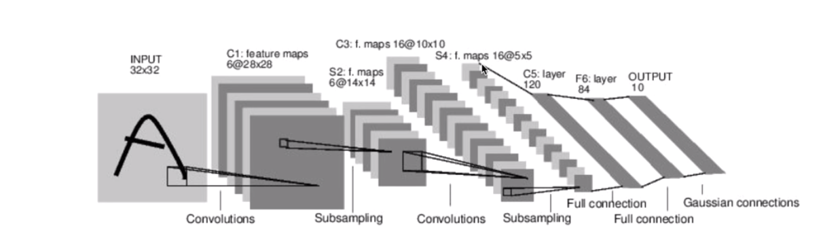
Convolutional Neural Networks
LeNet-5, Lecun 1980

Slide 31
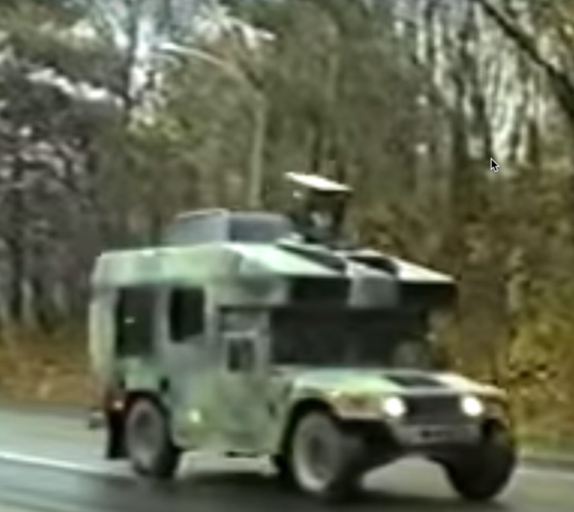
Popularity of Neural Network
Neural Network based Autonomous Car
NavLab 1984-1994, CMU
https://www.youtube.com/watch?v=5-acCtyKf7E
Load Detection & Wheel Control

Slide 32

Popularity of Neural Network
Terminator 2
https://www.youtube.com/watch?v=xcgVztdMrX4
“My CPU is a neural-net processor….a learning computer.”

Slide 33
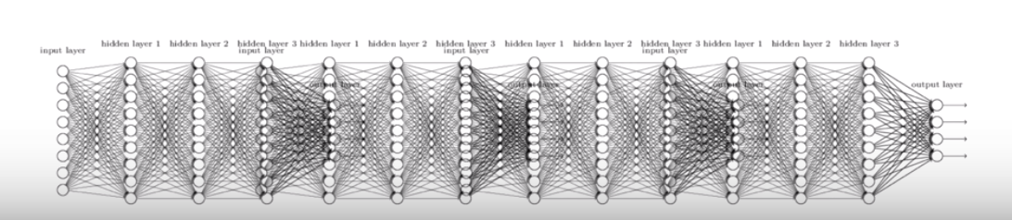
A Big problem
Backpropagation just did not work well for normal neural nets with many layers
Other rising machine learning algorithms: SVM, Random Forest, etc.
1995 “Comparison of Learning algorithms for Handwritten Digit Recognition” by LeCun et al. found that this new approach worked better.

Slide 34
Breakthrough
In 2006 and 2007 by Hinton and Bengio
(2006) Neural networks with may layers really could be trained well, if the weights are initialized in a clever way rather than randomly.
(2007)Deep machine learning methods are more efficient for difficult problems than shallow methods
Rebranding to Deep Nets, Deep Learning

Slide 35
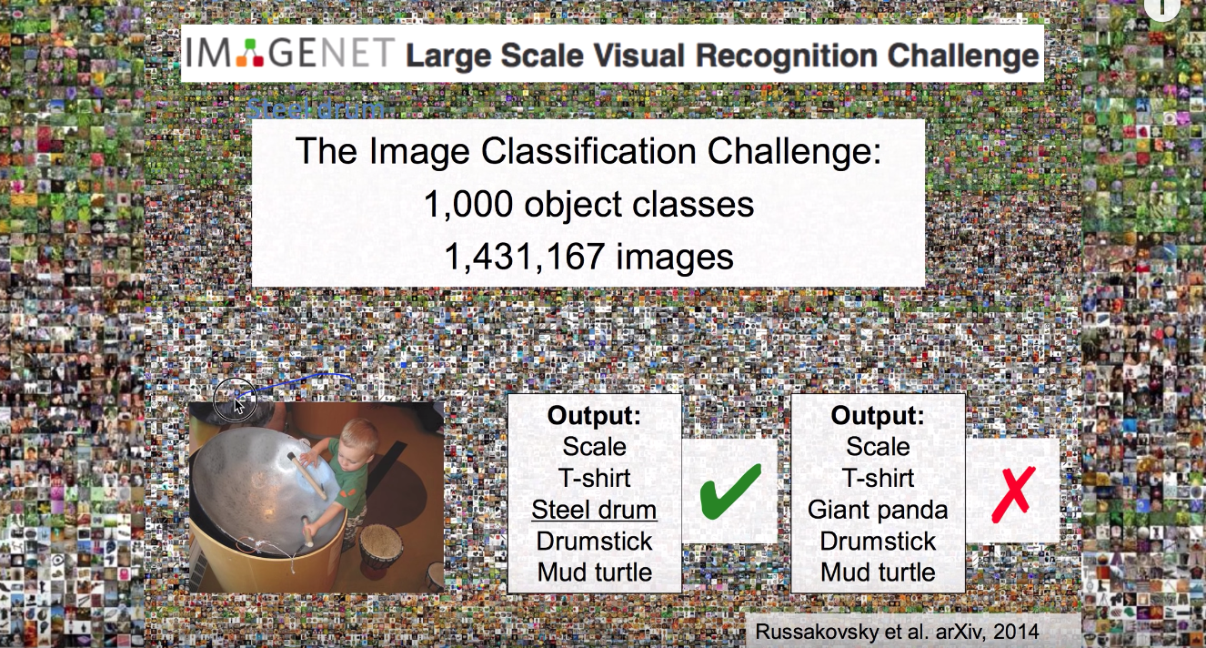
Breakthrough

Slide 36
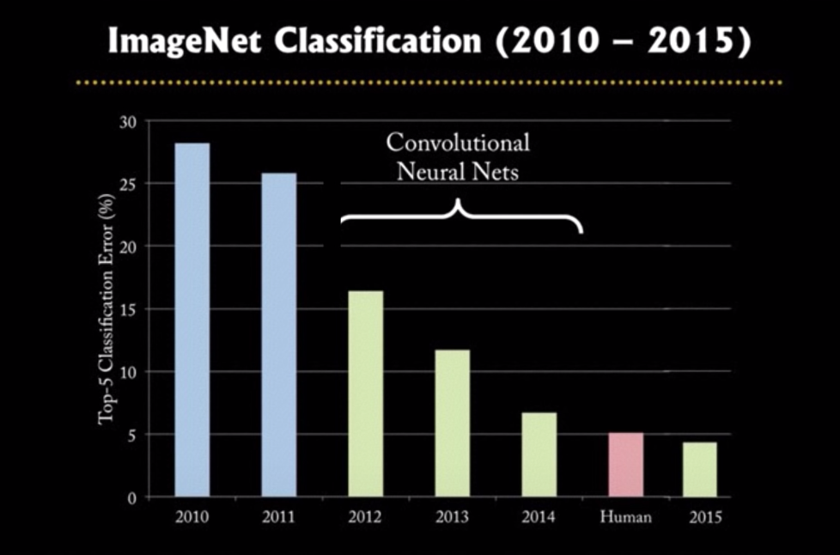
Breakthrough
26.2% ➔15.3%

Slide 37
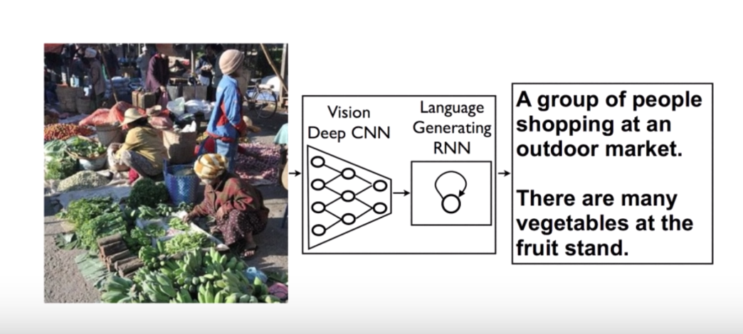
After Breakthrough
Neural Networks that can explain Photos

Slide 38
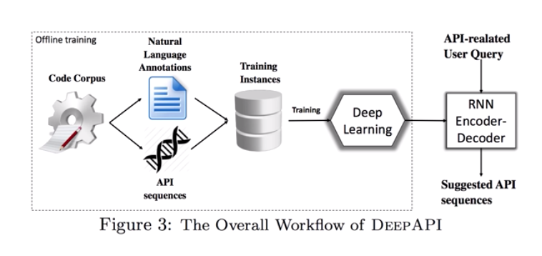
After Breakthrough
Deep API Learning
“Copy a file and save it to your destination path”
20%➔60%

Slide 39
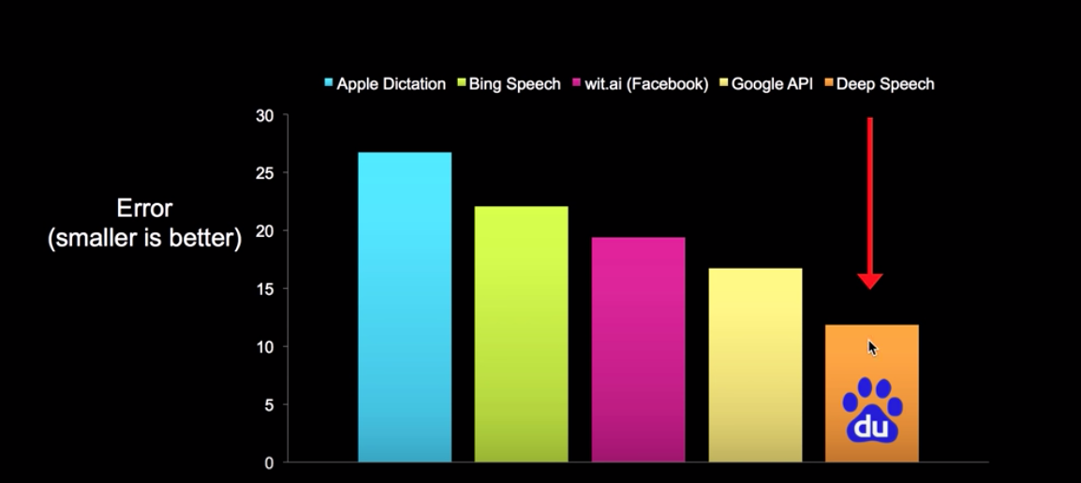
After Breakthrough
Speech recognition errors

Slide 40
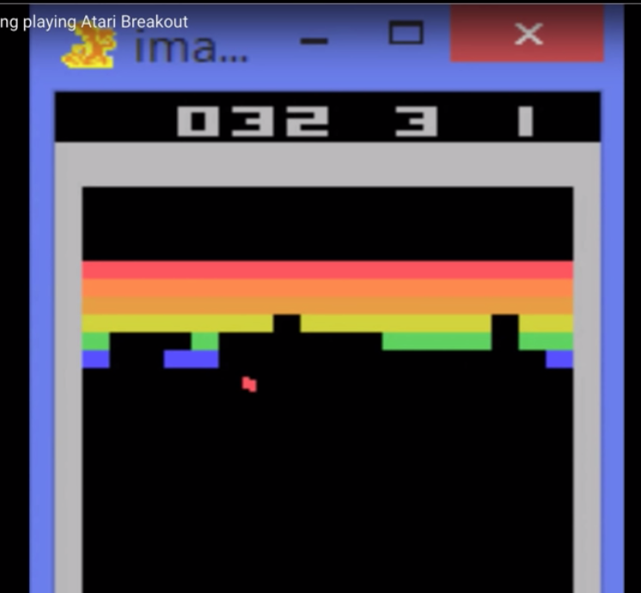
After Breakthrough
Altari

Slide 41
Geoffrey Hinton’s summary of findings up to today
Our labeled datasets were thousands of times too small
Our computers were millions of times too slow
We initialized the weights in a stupid way
We used the wrong type of non-linearity

